Slide 1

SCR and TIMS Advice Summary
Ben Sexton

Slide 2
SCR Website Feedback
The website would greatly benefit from an increase in contrast, especially for certain headings.
The website would also provide a better user experience if more space was added to areas, an example of a crowded area is provided on the next slide.
Another thing that’s very important to the user experience is colors, having colors that stand out in the correct areas can draw attention. This is very evident in the resource library as seen on the next slide.
While there are many things to fix, the positive aspects of the website are that pages such as the memo, imbox page, and others have consistent and bold colors bringing attention to the correct places.

Slide 3
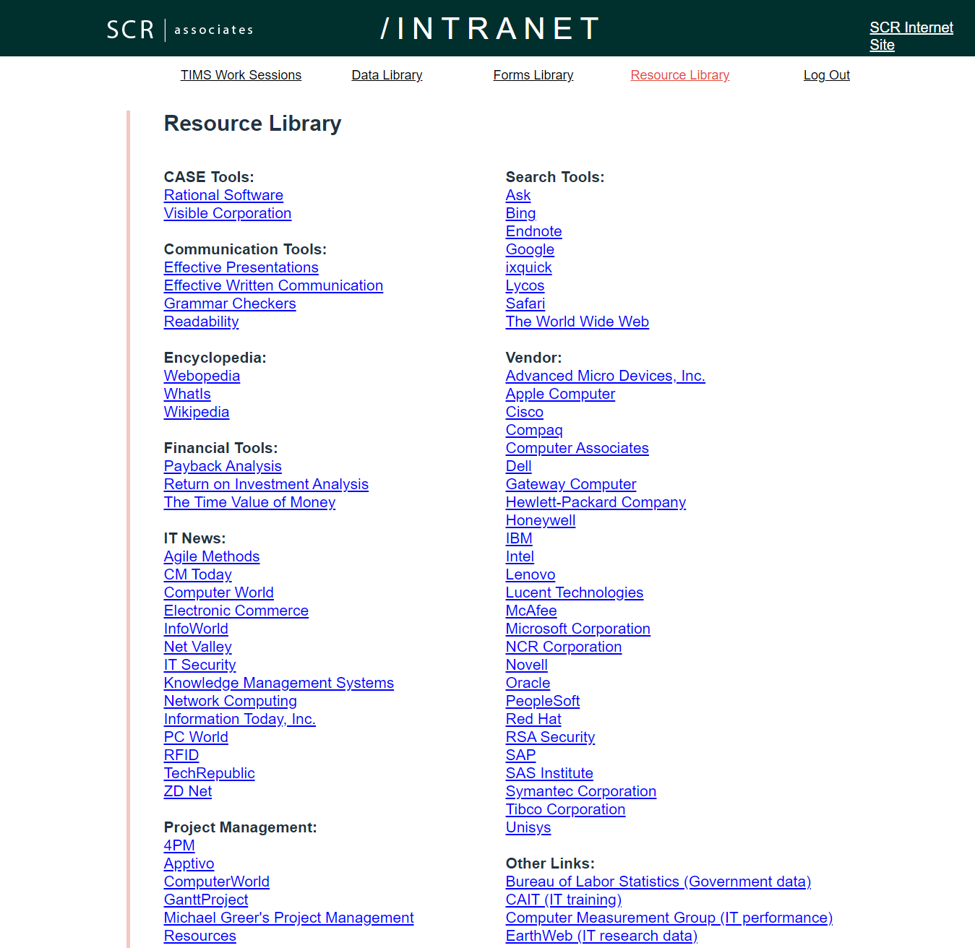
Website Feedback (Visual)
The resource library page of the SCR
website is a prime example of where proper colors
and spacing would vastly improve the overall user
experience.

Slide 4
SCR Corporate Goal
Implementing TIMS is a great step in the right direction and should boost SCR’s public view.
Since SCR is drastically changing, so is the corporate goal of the company.
The new mission statement needs to keep SCR’s core values, that the customer comes first, but also let everyone know how SCR will continue to put the customer first through the new program.
“As long as the mission statement reflects the common values of the company (training) it’ll bring more interest from the common visitor (Cox, 2021).”

Slide 5
Dos of – Project Management
Project management plays an important role on the successes of a project.
A major “do” of project management is to set realistic goals that are also still efficient (Satzinger, 2014).
It’s also important to monitor and manage projects effectively, this is done by implementing regular scheduled reviews, reporting, and meetings.
Risk management is also very important, as understanding the risks involved with a certain goal can minimize the chances of a setback or failure (Satzinger, 2014).

Slide 6
Don’ts of – Project Management
A list of things not to do when leading a project could be endless, but there are three big nos.
Do not be toxic to the team members, as it will only provide negative impacts.
Do not set an unrealistic standard, whether that’s cost, time, or scope.
Do not be selfish, try to understand everyone’s point of view on the project.

Slide 7
TIMS Questionnaire Methodology
Questionnaires can be one of the most effective tools in terms of measuring preferences and opinions, while also being cheap and quick (Mcleod).
The questionnaire targets prospective and former students, men and women equally, and a spread of age groups.
Spreading the questionnaire’s reach allows SCR to utilize data to know which group to advertise toward.

Slide 8

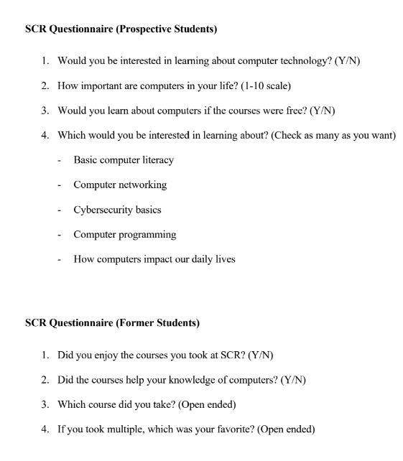
TIMS Questionnaire

Slide 9
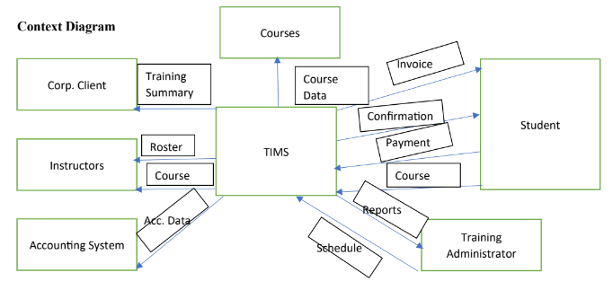
TIMS Context Diagram
The context diagram provides a brief overview of how the system functions.
As you can see, everything connects with TIMS and it also gives an overview of how the data moves.

Slide 10
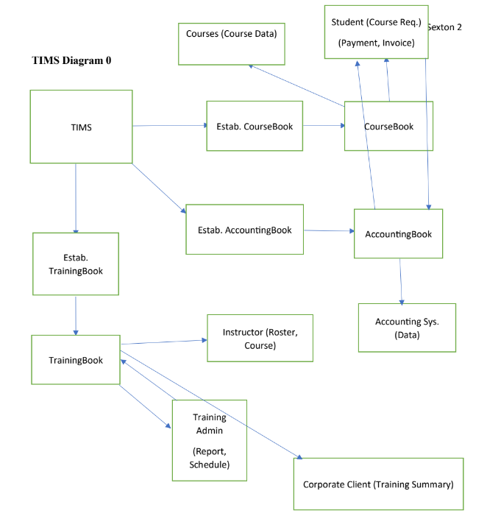
TIMS Diagram 0
This diagram is a bit more in depth and shows how data moves and is created.
It should give a better understanding of how TIMS is functioning.

Slide 11
TIMS Use Cases
The use cases for TIMS include student payment, determining schedules and maintaining records.
The actors include the instructor, student, training admin, and corporate client.
The student registration model flows as follows.
Student accesses registration page and enters details (ID, name, address, contact).
Student submits information, and then a training admin reviews the info, creates the account and confirms the student.

Slide 12
Software Packages and Outsourcing TIMS
Vertical software packages are quite hard to find for training management systems, but Training Orchestra provides one.
Outsourcing was discussed during this part of the system development cycle, and it should only be undertaken if the budget allows.
The most important thing to realize about outsourcing “is that the solution can only be as good as the outsourcing firm that provides the service” (Tilley, 2020).
The two types of outsourcing TIMS would greatly benefit from include application service providers (ASP), and internet business services (IBS).

Slide 13
Outsourcing Continued
Outsourcing comes with many positives and negatives, some of the positives include less time consuming, no need for management, resources may be allocated to other things, and the result may be better than the in-house alternative.
Some of the disadvantages include cost, security and that some staff may be scared of their job security.
Outsourcing is situational and all pros and cons must be weighed, in this situation it would be beneficial due to the cost-benefit data provided by SCR.

Slide 14
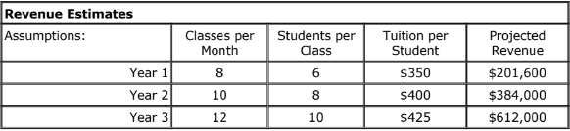
SCR Revenue Estimates

Slide 15
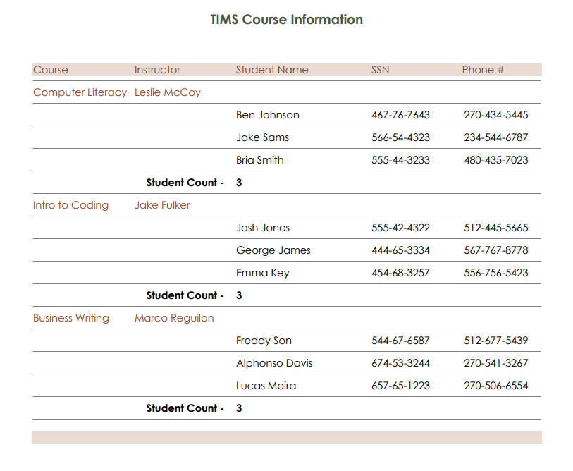
TIMS Detail Report
The detail report must be properly spaced,
and the colors must highlight the important things
while also making the data easily readable.

Slide 16
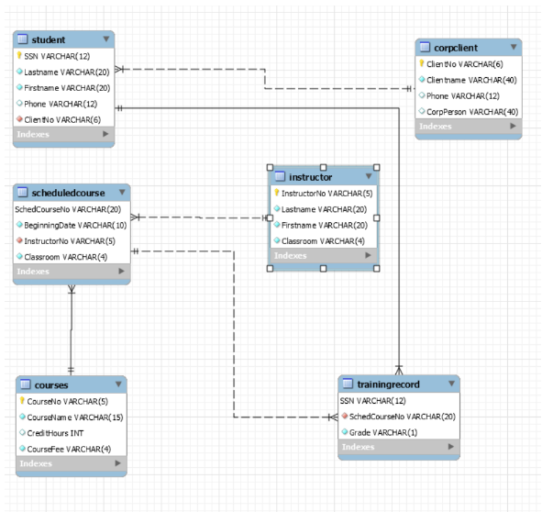
TIMS ERD

Slide 17
TIMS Executive Summary
TIMS provides great opportunities to the students while also boosting the public perception of SCR as TIMS provides valuable courses that increase employability.
The TIMS project will be in profit within two years, and a net profit within three.
The best way to implement TIMS is through Client-Server architecture, as it allows for a client to connect to a central server (n.d.).
This architecture also allows for high data availability, as all students can access the data at any time (n.d.).
Client-Server architecture also has the ability to scale with the program.

Slide 18
TIMS Integration Plan - Install
Five steps were formed for the TIMS testing plan, these are presented below.
Prepare a separate test environment
Provide training for users, managers, staff
Perform data conversion and system changeover
Carry out post implementation review
Present the final report

Slide 19
TIMS Integration Plan - Training
Two steps need to be taken to break it down further, identifying who needs training and what type, then how it will be provided.
Identifying who needs to be trained was simple, the people who will be using and maintaining the system must understand it, so the IT staff, users, and managers
Since TIMS will most likely be outsourced, the vendor should provide a training program to be used, and managers also are advised to create tutorials or webinars that can be used remotely.

Slide 20
Future of TIMS – Version Control
Version control of TIMS is necessary to make sure the system doesn’t degrade over time.
There are three main things to consider when implementing version control, keeping a log with changes to files, branching and merging code, and tracing all changes (Atlassian).
If version control is properly implemented, it makes it much easier to look back at code/files to correct any human error.
Also gives the ability for rollbacks.

Slide 21
Future of TIMS – Configuration Management
Configuration management is very similar to version control, as it also relies heavily on tracing files, etc.
It’s “an important tool for managing system changes and costs after a system becomes operational” (Tilley, 2020).
Configuration management primarily helps to keep track of data and reports, which is essential if TIMS is continuously updated through the future (Tilley, 2020).

Slide 22
Future of TIMS – Capacity Planning
Capacity planning is the final step to ensuring TIMS has a good future.
The first step of capacity planning is to develop a model of the system’s workload and performance, then analyzing it (Tilley, 2020).
Next, use a what-if analysis to evaluate certain scenarios TIMS may face in the future.
As long as the data is analyzed to determine what needs to be done to TIMS to reach the goal, the future should be very bright.

Slide 23
References
10 Project Management Dos and Don'ts. Team Consulting. (n.d.). https://www.team-consulting.com/insights/project-management-10-dos-and-donts/
Atlassian. (n.d.). What is version control: Atlassian Git Tutorial. Atlassian. Retrieved October 24,2021, from https://www.atlassian.com/git/tutorials/what-is-version-control.
Cox, L. K. (2021, May 25). 27 Truly Inspiring Company Vision and Mission Statement Examples. HubSpot Blog. https://blog.hubspot.com/marketing/inspiring-company-mission-statements.
Mcleod, S. (n.d.). Questionnaire: Definition, Examples, Design and Types. Questionnaire: :Definition, Examples, Design and Types | Simply Psychology.https://www.simplypsychology.org/questionnaires.html
Satzinger, J. W. (2014). Introduction to systems analysis and design: an agile, iterative approach.
Cengage Learning.
Encyclopædia Britannica, inc. (n.d.). Client-server architecture. Encyclopædia Britannica.Retrieved September 14, 2021, from https://www.britannica.com/technology/client-server-architecture.

Slide 24
References
Tilley, S. R. (2020). Systems analysis and design. Boston, MA

